Slide 1
Software Development Process and Activities
CS 441, Spring 2020, Yongjie Zheng

Slide 2
Software Process
A set of activities that leads to the production of a software product
  What product we should work on next
  What criteria that work product must satisfy
There is no standard or ideal process!
  For some systems, such as critical systems, a very structured development process is required.
  For business systems, with rapidly changing requirements, a flexible process is likely to be more effective.
  For large systems, a mixed process is often preferred.
CS 441: Software Engineering

Slide 3
Software Process Models
Waterfall Model
V-Model
Prototyping
Iterative Process
  Incremental Development
  Spiral Model
  Agile Methods
Rational Unified Process (RUP)
CS 441: Software Engineering

Slide 4
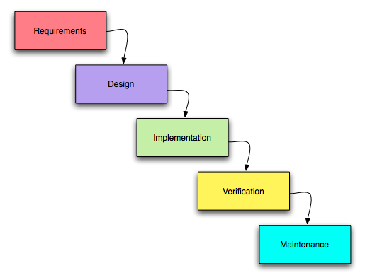
Waterfall Model
CS 441: Software Engineering

Slide 5
Waterfall Model
Pros
  A plan-based, document-driven, rigor process
  Fits with other engineering process model
Cons
  Premature freezing of requirements
  Inflexibility
Usages
  Critical systems
  Large systems (hardware & software)
  Different development teams in different places
  Long lifetime
CS 441: Software Engineering

Slide 6
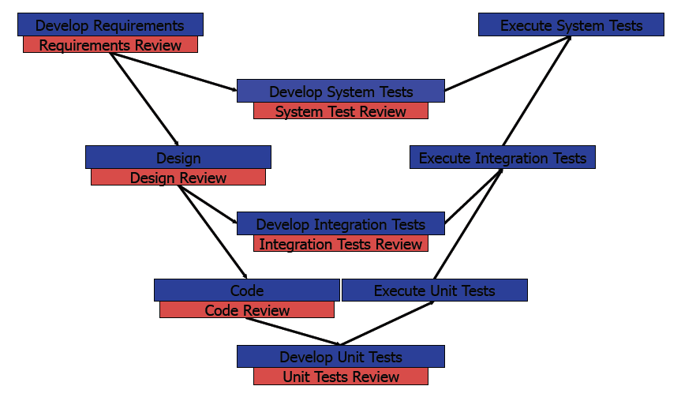
V-Model (the extension of Waterfall)
CS 441: Software Engineering

Slide 7
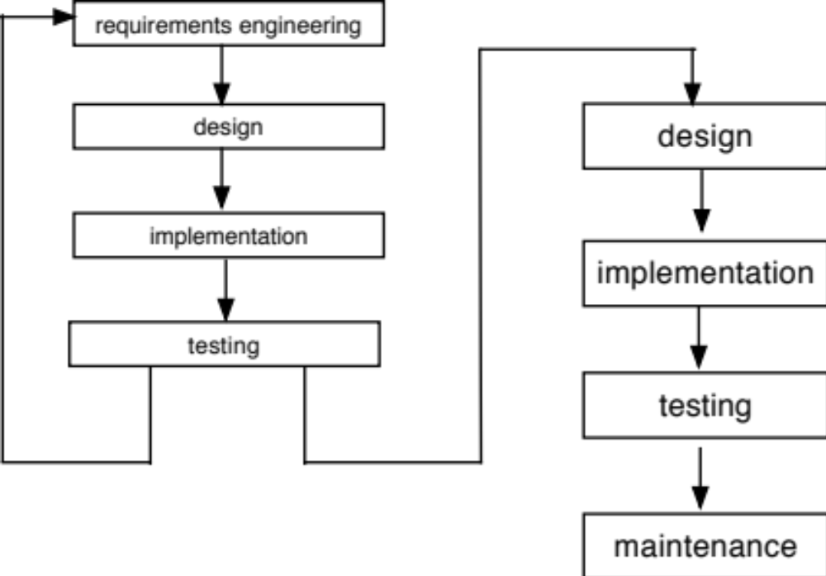
Prototyping
CS 441: Software Engineering

Slide 8
Prototyping
Prototype
  Prototype is a working model of a software system, which emphasizes certain aspects.
  Usually starts with requirements that are not well understood
Pros
  A good way to clarify user requirements
  Useful for user interface design
Cons
  The process is not visible
  The resulting system can be poorly structured
CS 441: Software Engineering

Slide 9
Iterative Processes
The essence of iterative processes is that the specification is developed in conjunction with the software.
  Incremental Development
  Spiral Model
  Agile Methods
CS 441: Software Engineering

Slide 10
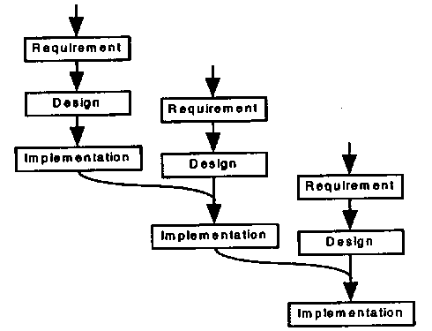
Incremental Development
CS 441: Software Engineering

Slide 11
Incremental Development
The functionality of the system is produced and delivered to the customer in small increments.
Starts with the user requirements that are best understood, or essential features.
Each release is a mini-waterfall.
Pros
  Avoids the “Bing Bang” effect.
  The most important system services receive the most testing.
Cons
  Contractual problems
  Hard to manage
CS 441: Software Engineering

Slide 12
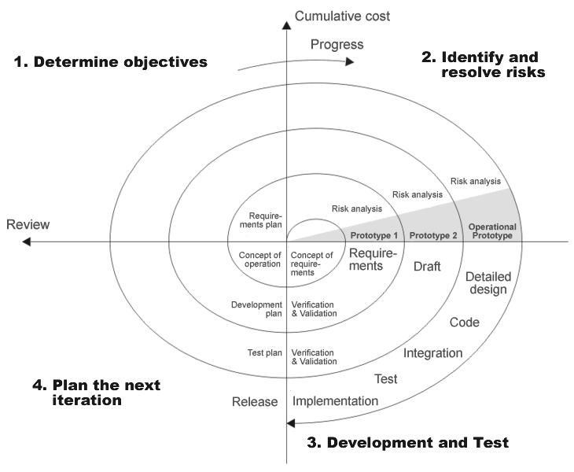
Spiral Model
CS 441: Software Engineering

Slide 13
Spiral Model
A risk-driven process model
Each loop in the spiral consists of:
  Identify objectives and alternatives
  Evaluate the alternatives, identify and resolve risks
  Develop the identified portion of the product
  Plan for succeeding phases
Pros
  Subsumes previous moels
Cons
  Not clear how to analyze risk
CS 441: Software Engineering

Slide 14
Agile Methods
Traditional plan-based approaches (waterfall, spiral, incremental) often involve a significant overhead in planning, designing, and documenting the system.
Agile methods allow the development team to focus on the software itself rather than on its design and documentation
CS 441: Software Engineering

Slide 15
Agile Methods
Principles
  Customer involvement
  Incremental delivery
  No prescriptive process
  Embrace change
  Focus on code
  Maintain simplicity
Examples
  Extreme Programming (XP)
    Pair programming
    Test-driven development
CS 441: Software Engineering

Slide 16
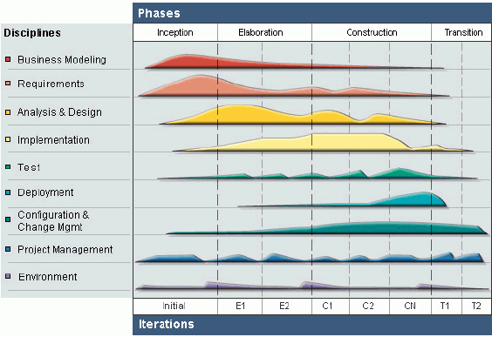
Rational Unified Process (RUP)
CS 441: Software Engineering

Slide 17
Rational Unified Process (RUP)
Separation of phases and development activities (workflows)
  Four phases: Inception, Elaboration, Construction, Transition
  Nine workflows: Business modeling, Requirements, Analysis and design, Implementation, Testing, Deployment, Configuration and change management, Project management, Environment
In principle, all of RUP workflows may be active at all phases of the process.
A hybrid of traditional process models
  A phased model where phases are more related to business
  Each phase is enacted in an iterative way
  The whole set of phases may also be enacted incrementally
CS 441: Software Engineering

Slide 18
Software Engineering Activities (covered in this course)
Requirements Analysis and Specification
  Requirements Specification
Software Architecture and Design
  Architectural Design
  Detailed Design
Software Implementation
  Development Environment
Software Testing
  Unit Testing
Software Maintenance
  Version Control
CS 441: Software Engineering

Slide 19
Other Software Engineering Activities and Topics (not covered)
Software Deployment
Software Refactoring
Software Metrics
Software Mining
Software Usability
Software Product Line
…
CS 441: Software Engineering

